Slide 1

Zombie Adventure
Text base python app

Slide 2
Storyline
So the storyline is as follows.
You are a survivor in a post apocalyptic would, your job is to navigate through the building and not die. You collect weapons and items on the way through each giving you a certain amount of points, if you make it out alive your points are then tallied and shown at the end of the game.

Slide 3
Main Features & requirements
The game is a terminal based application meaning it needs to be run on a terminal like windows terminal or terminal on a macbook. As long as you have those it will run successfully.
So the game has 4 main features;
Inventory system, that stores your items that you find and pick up. It will also remove those items if you use them
Scoring system, the game will keep score depending on what items you find and will tell you your total at the end of the game
User functionality, so what I mean by this is because it is a text based game the actions are determined by the user on what happens next, depending on what is typed determines what the player does.
Enemies, the game does have enemies and depending on what you have found in the building determines what you can do with those enemies

Slide 4
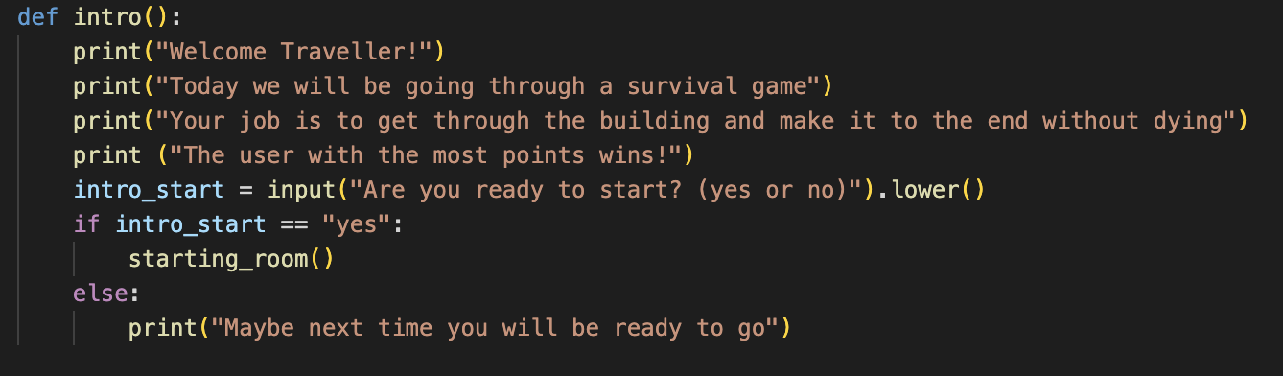
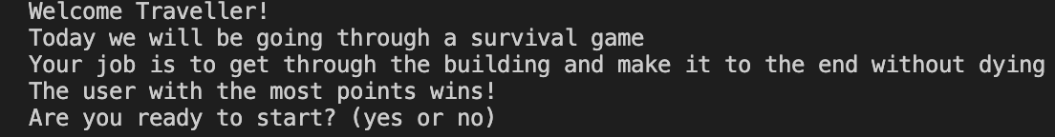
Intro

Slide 5
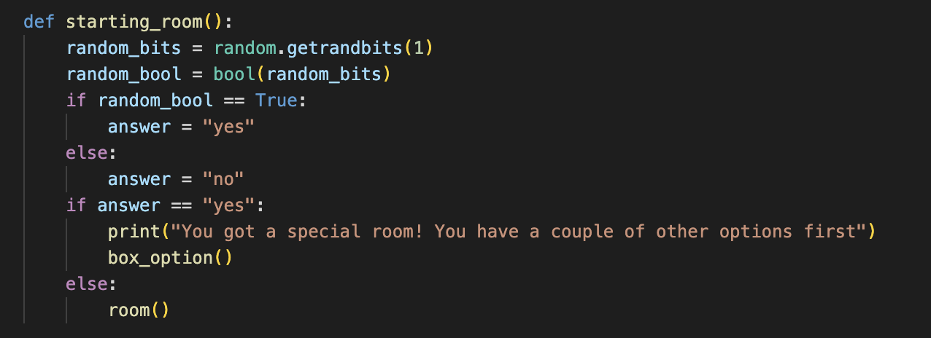
Starting Room

Slide 6


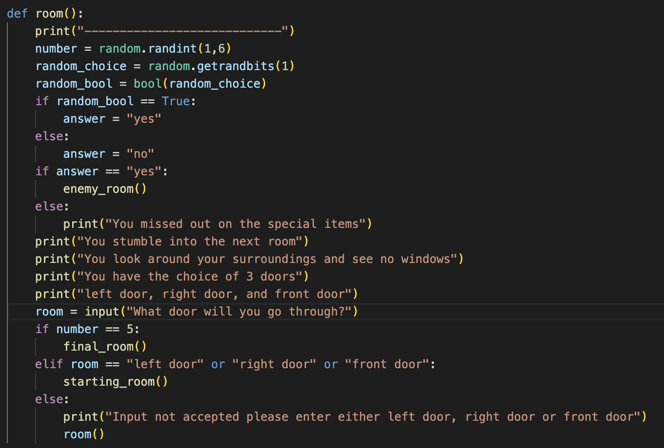
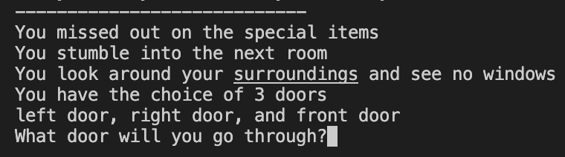
Main Room Function

Slide 7
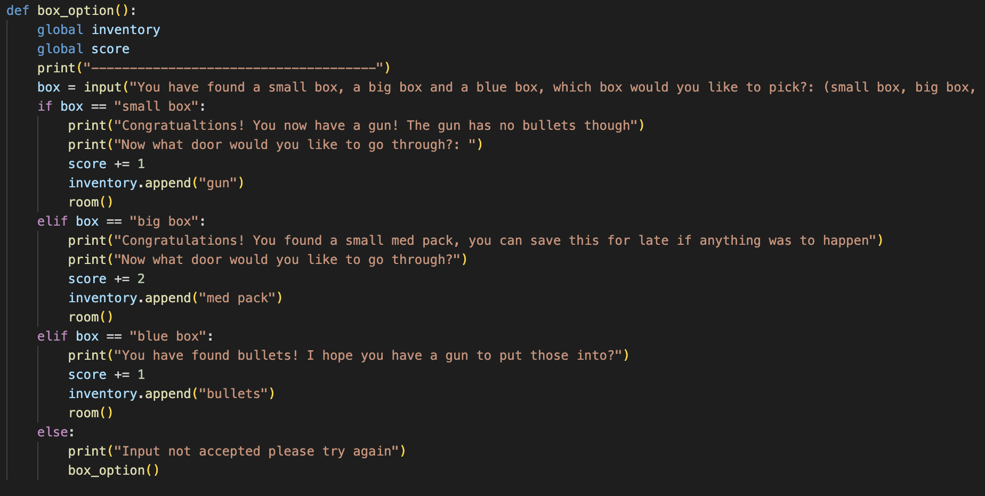
Items

Slide 8
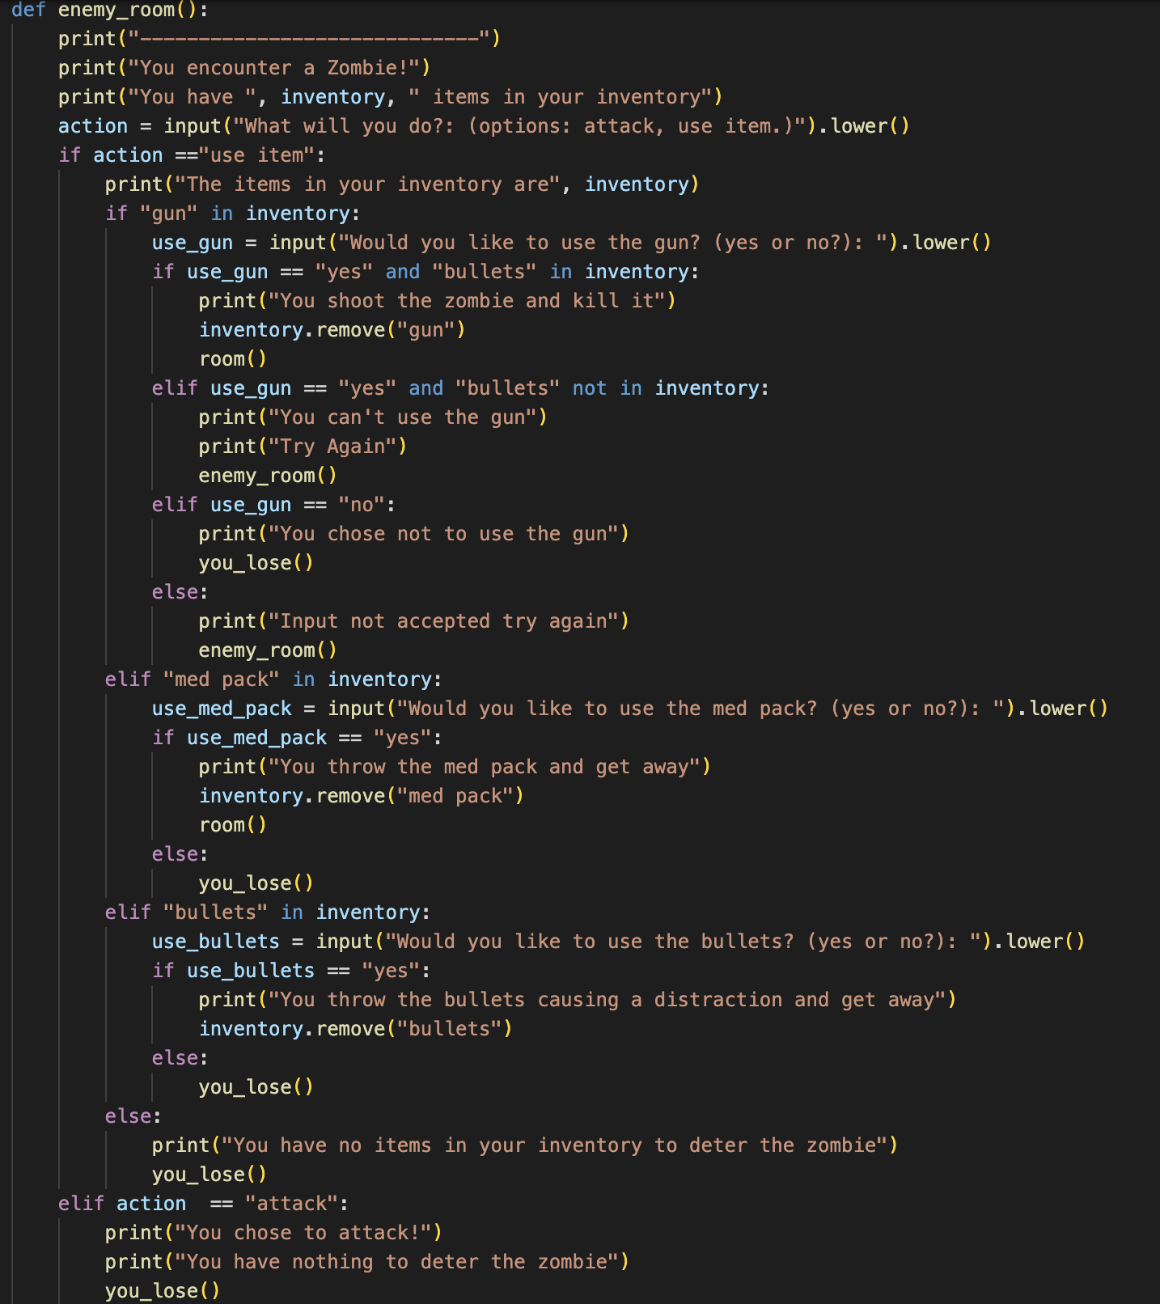
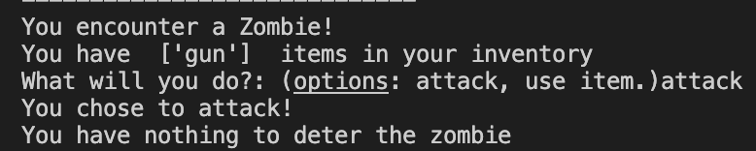
Enemies

Slide 9
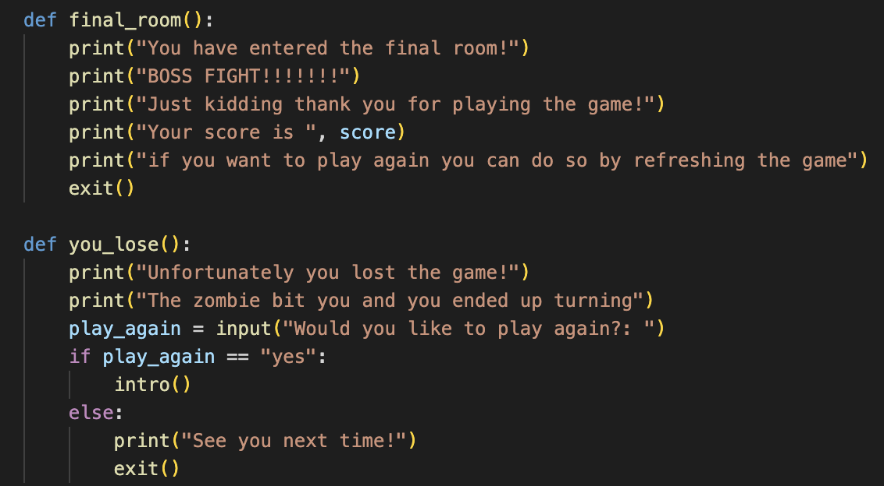
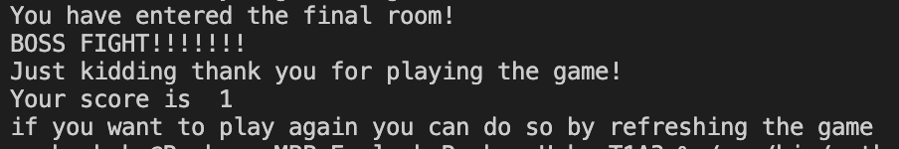
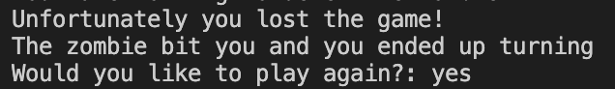
Final room and you lose screen

Slide 10
Challenges Favorite part

Slide 11
Conclusion

